Slide 1
Shooting Method
by
Dr. Md. Rajibul Islam
CSE, UAP

Slide 2
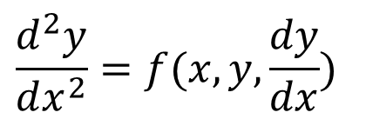

Shooting Method
The shooting method uses the methods used in solving initial value problems. This is done by assuming initial values that would have been given if the ordinary differential equation were an initial value problem. The boundary value obtained is compared with the actual boundary value. Using trial and error or some scientific approach, one tries to get as close to the boundary value as possible.

Slide 3
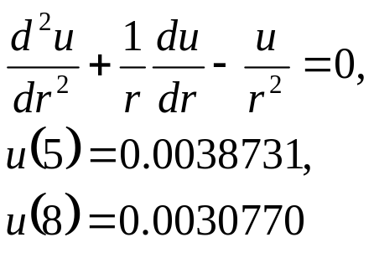
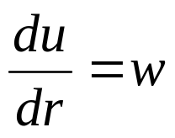
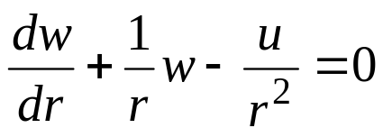
Example
r
u=radial displacement
r= radial location
b
a
Let
Where a = 5
and b = 8
Then

Slide 4
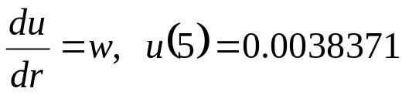
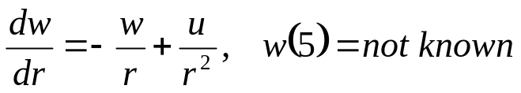
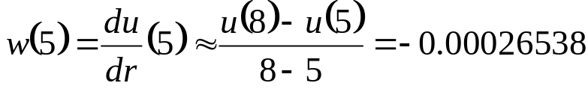
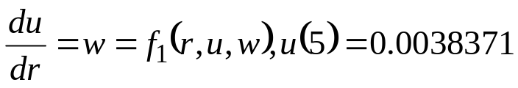
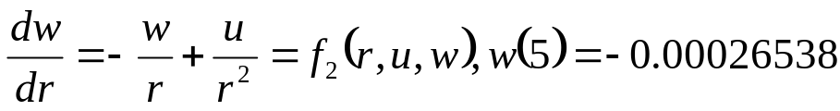
Solution
Two first order differential equations are given as
Let us assume
To set up initial value problem

Slide 5
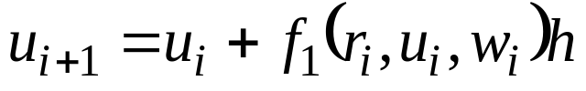



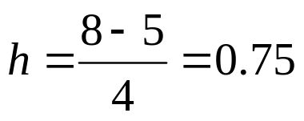
Solution Cont
Using Euler’s method,
Let us consider 4 segments between the two boundaries, and then,

Slide 6
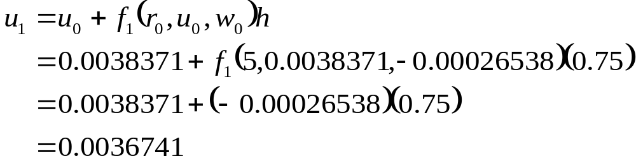
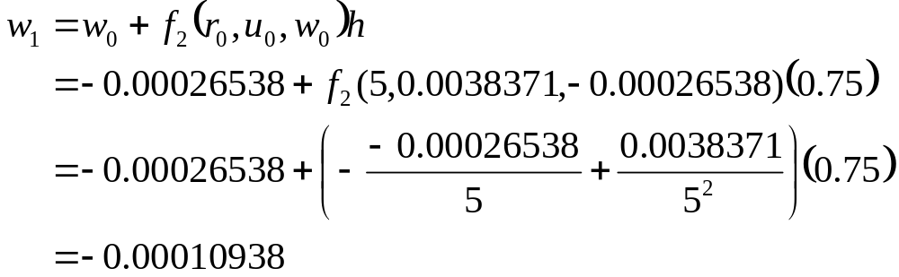
Solution Cont
For

Slide 7


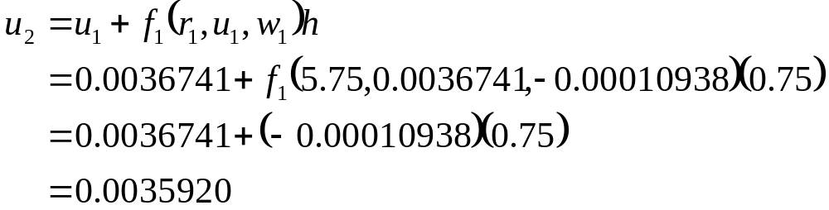
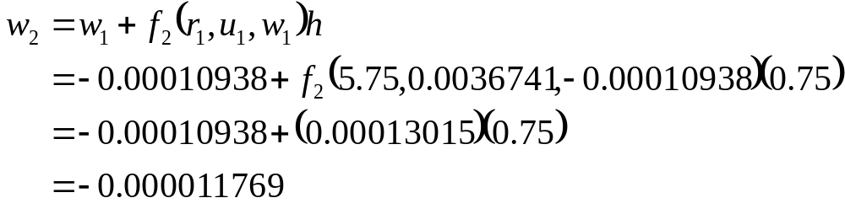
Solution Cont
For

Slide 8

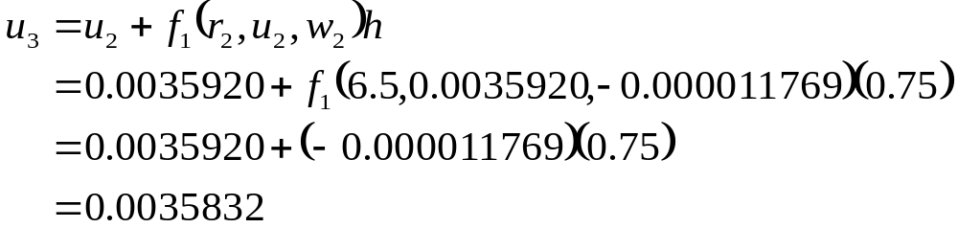
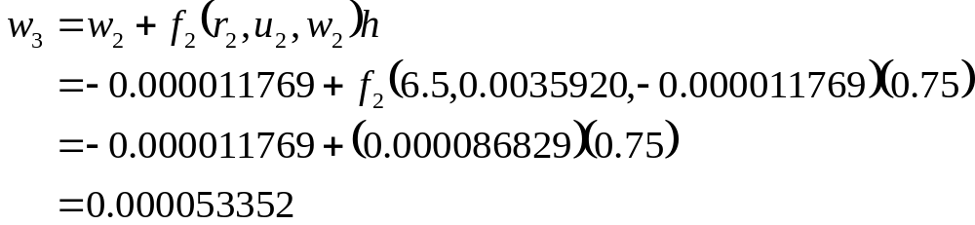
Solution Cont
For

Slide 9


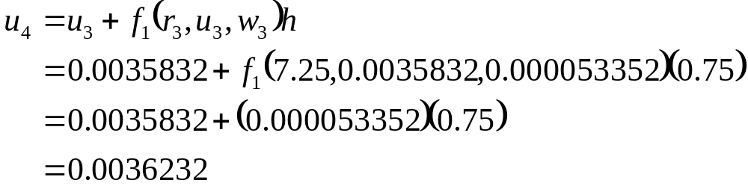
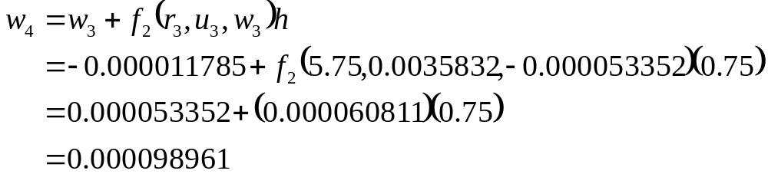


Solution Cont
For
So at

Slide 10
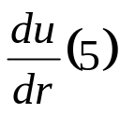
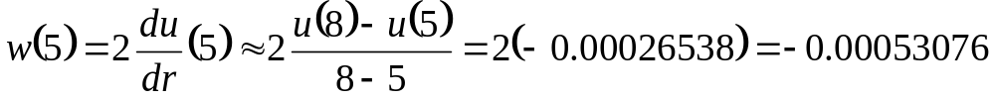



Solution Cont
Let us assume a new value for
Using
and Euler’s method, we get
While the given value of this boundary condition is

Slide 11
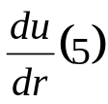

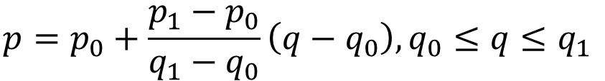




Solution Cont
Using linear interpolation on the obtained data for the two assumed values of
we get
Using
and repeating the Euler’s method with

Slide 12







Solution Cont
Using linear interpolation to refine the value of
till one gets close to the actual value of
which gives you,

Slide 13
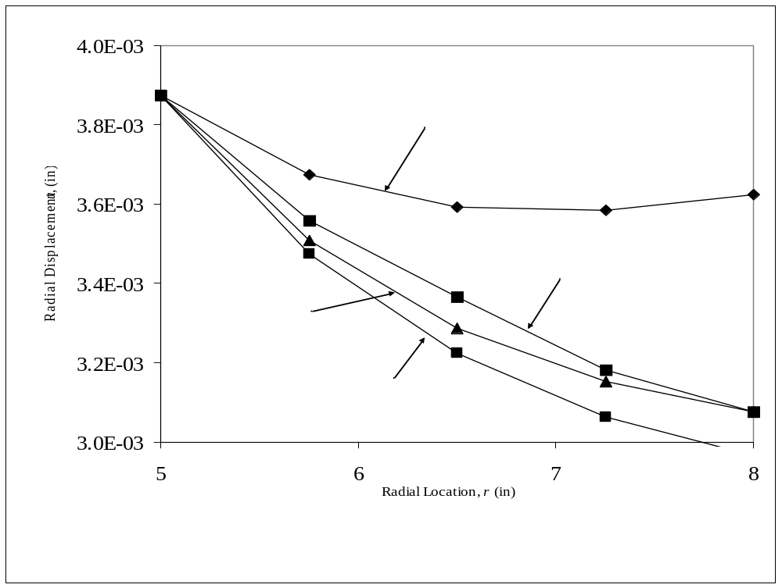
Comparisons of different initial guesses

Slide 14
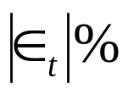
Comparison of Euler and Runge-Kutta Results with exact results
Table 1 Comparison of Euler and Runge-Kutta results with exact results.
r (in) | Exact (in) | Euler (in) |  | Runge-Kutta (in)
5 5.75 6.5 7.25 8 | 3.8731×10⁻³ 3.5567×10⁻³ 3.3366×10⁻³ 3.1829×10⁻³ 3.0770×10⁻³ | 3.8731×10⁻³ 3.5085×10⁻³ 3.2858×10⁻³ 3.1518×10⁻³ 3.0770×10⁻³ | 0.0000 1.3731 1.5482 9.8967×10⁻¹ 1.9500×10⁻³ | 3.8731×10⁻³ 3.5554×10⁻³ 3.3341×10⁻³ 3.1792×10⁻³ 3.0723×10⁻³ | 0.0000 3.5824×10⁻² 7.4037×10⁻² 1.1612×10⁻¹ 1.5168×10⁻¹

Slide 15
THE END

